Slide 1
CardScout: an Intelligent Credit Card Finder.
CAPSTONE PROJECT
Presented By:
Student Name- Tanmay Santosh Sanap
College Name- B.K Birla College
Department- B.Sc Data Science
AICTE Student ID- STU68655f0b0ffe71751473931

Slide 2
OUTLINE
Problem Statement (Should not include solution)
Proposed System/Solution
System Development Approach (Technology Used)
Algorithm & Deployment
Result
Conclusion
Future Scope
References

Slide 3
Problem Statement
Maintaining a healthy lifestyle is challenging for students due to busy schedules, limited budgets, and lack of personalized guidance. Most fitness applications provide generic workout and diet plans that do not consider individual body types, cultural food habits, or available resources. As a result, students often follow unrealistic routines that are difficult to sustain and fail to achieve their fitness goals.
There is a critical need for an intelligent tool that can:
➤ Analyze individual data — including age, weight, BMI, fitness goals, and daily schedule — to generate personalized fitness recommendations instead of generic plans.
➤ Create customized workout routines tailored to the user’s fitness level, available equipment, and time constraints.
➤ Provide culturally appropriate diet plans by suggesting Indian meals that match nutritional needs and budget limitations.
➤ Recommend practical lifestyle changes that help students maintain consistency and achieve long-term health improvements through AI-driven guidance.

Slide 4
Proposed Solution
This project is an automated, AI-driven wellness assistant that replaces generic fitness advice with personalized workout and nutrition planning. By using AI, the system generates practical routines and meal plans tailored to individual student needs, ensuring they are effective, culturally appropriate, and budget-friendly.
Core Components of the Solution:
• AI Wellness Dashboard: A simple interface that displays personalized fitness insights such as daily calorie needs, workout recommendations, and nutrition targets based on user data.
• Personalized Workout Planner: Generates customized exercise routines tailored to fitness level, body type, available equipment, and time availability.
• Smart Diet Planner: Provides Indian meal suggestions aligned with calorie and protein requirements while respecting cultural food habits and budget constraints.
• Student Lifestyle Optimization: Recommends realistic habits and scheduling tips to help students maintain consistency despite academic workload and hostel living conditions.
• Cloud-Based Deployment: The application is deployed online, allowing users to access their personalized fitness and diet plans anytime, anywhere.

Slide 5
System Approach
❖ Development Tool ➤ Visual Studio Code
❖ Programming Language ➤ Python
❖ Framework Used ➤ Streamlit (to build the web application)
❖ Libraries Used ➤ Pandas & NumPy (data processing & BMI calculation)
❖ AI Integration ➤ Gemini API (used to generate personalized workout & diet recommendations)
❖ Deployment Platform ➤ Streamlit Cloud

Slide 6
Algorithm & Deployment
1. Algorithm Workflow:-
▪ Step 1: User Input User enters age, weight, height, fitness goal, and diet preference.
▪ Step 2: Data Processing System calculates BMI, calorie needs, and nutrition requirements.
▪ Step 3: AI Recommendation Gemini API analyzes the data and generates
personalized workout plan
daily diet recommendations
▪ Step 4: Result Display The system displays a customized fitness and meal plan.

Slide 7
Algorithm & Deployment
2. Deployment (Step-by-Step):-
Step A: Version Control (GitHub) ▪ Project code is stored in a GitHub repository. ▪ API keys are stored securely using environment variables.
Step B: Cloud Hosting (Streamlit Cloud) ▪ The app is deployed using Streamlit Cloud. ▪ Required libraries are installed automatically.
Step C: Secret Key Setup ▪ Gemini API key is added securely in Streamlit secrets. ▪ Keeps API keys safe and hidden.
Step D: Production Launch ▪ App becomes live and accessible to users. ▪ Users can access it through a public URL.

Slide 8
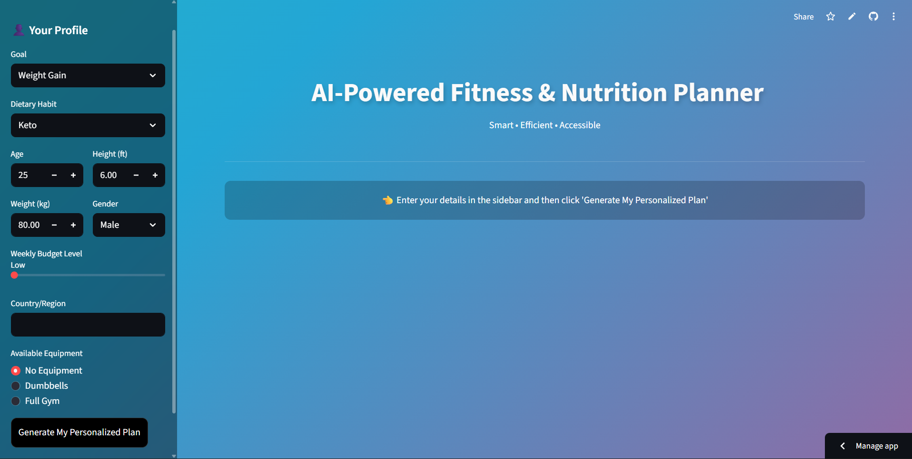
Result

Slide 9
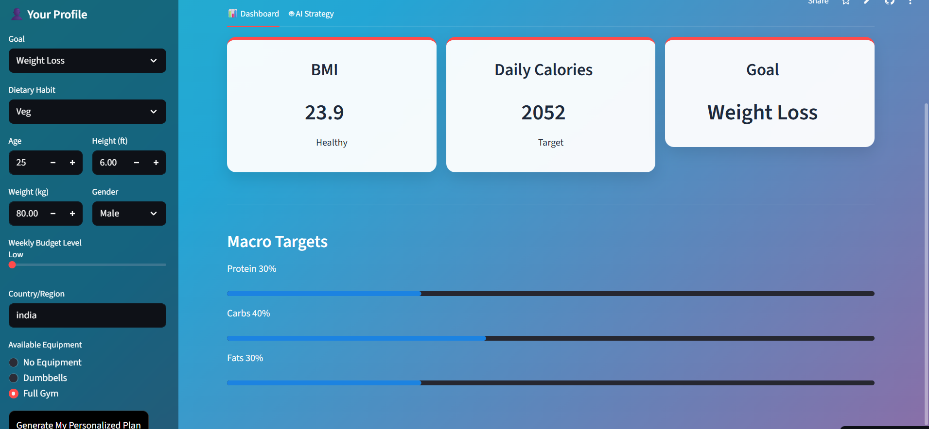
Result

Slide 10
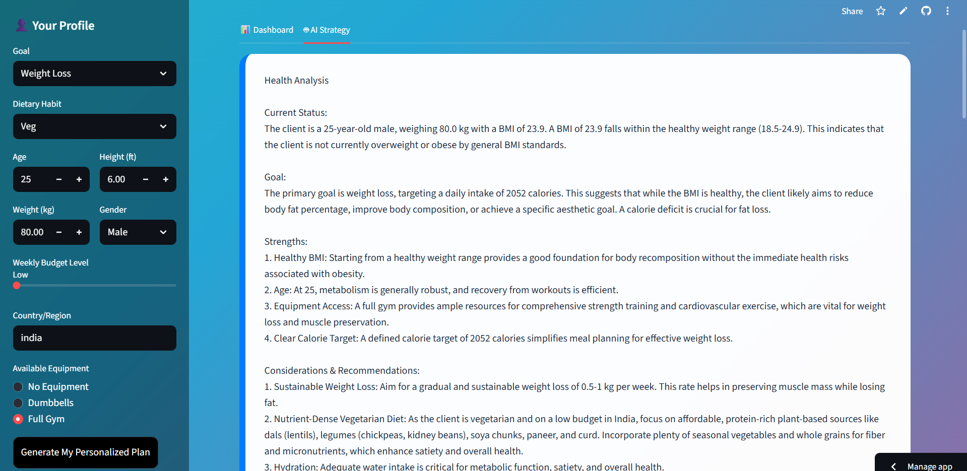
Result

Slide 11
Conclusion
➤ Personalized Workout & Diet Planner with AI demonstrates how Artificial Intelligence can simplify fitness planning for students by providing customized workout routines and nutrition guidance based on individual needs.
➤ By integrating Gemini AI for intelligent recommendations and deploying the system as a web application, the project moves beyond generic fitness advice to deliver a truly personalized and practical wellness solution.
➤ The successful deployment of this system ensures that students can access affordable, culturally appropriate, and goal-oriented fitness guidance anytime, anywhere.
➤ Ultimately, the system empowers users to adopt healthier lifestyles, maintain consistency, and achieve long-term fitness goals with confidence.

Slide 12
Future scope
AI Progress Tracking & Smart Insights: ▪ Implement an AI module to track user progress and provide real-time fitness improvement insights. ▪ This will help users stay motivated and achieve better results.
Personal Health Monitoring & Coaching: ▪ Integrate daily activity tracking and personalized health tips. ▪ Send reminders for workouts, hydration, and healthy habits
.
Mobile App Integration: ▪ Develop a mobile application for easier access and notifications. ▪ Enable push alerts for workout schedules and meal timings.
Wearable Device Integration: ▪ Connect with smartwatches or fitness bands to monitor steps, heart rate, and calories burned.
Advanced AI Fitness Coach: ▪ Add an AI chatbot to answer fitness and nutrition questions in real time.

Slide 13
References
➤ Google AI Studio: Documentation for the Gemini AI model used to generate personalized workout and diet recommendations.
➤ Streamlit Documentation: Guide for building interactive web applications and deploying data apps.
➤ Python Documentation: Reference for core programming and application development.
➤ Pandas & NumPy Libraries: Documentation for data processing, calculations, and BMI analysis.
➤ WHO & Nutrition Guidelines: Reference standards for BMI classification and daily nutritional requirements
.
➤ Streamlit Cloud: Documentation for cloud deployment and secure secret key management.

Slide 14
Github link
Github Link: https://github.com/Tanmaysanap45/AICTE-BATCH7-MY-PROJECT.git
Deployment Link: https://ai-wellness-app.streamlit.app/

Slide 15
THANK YOU

